Slide 1
MODULE III

Slide 2
Syllabus of module 3-Part1
More features of Java: Packages and Interfaces - Defining Package, CLASSPATH, Access Protection, Importing Packages, Interfaces.
Exception Handling - Checked Exceptions, Unchecked Exceptions, try Block and catch Clause, Multiple catch Clauses, Nested try Statements, throw, throws and finally.

Slide 3
Interfaces
Interface is basically a kind of class.
The difference is that interface can contain only abstract methods and final fields.
Using the keyword interface, a class can be fully abstracted from its implementation. i.e. using interface one can specify what the class must do without specifying how it does it.
An alternative approach to support Multiple Inheritance
Syntax :
interface Interfacename
{
variable declaration;
methods declaration;
}
Variables are declared as follows:
static final type variablename=value;
Methods are declared as follows:
returntype methodname(parameterlist);

Slide 4
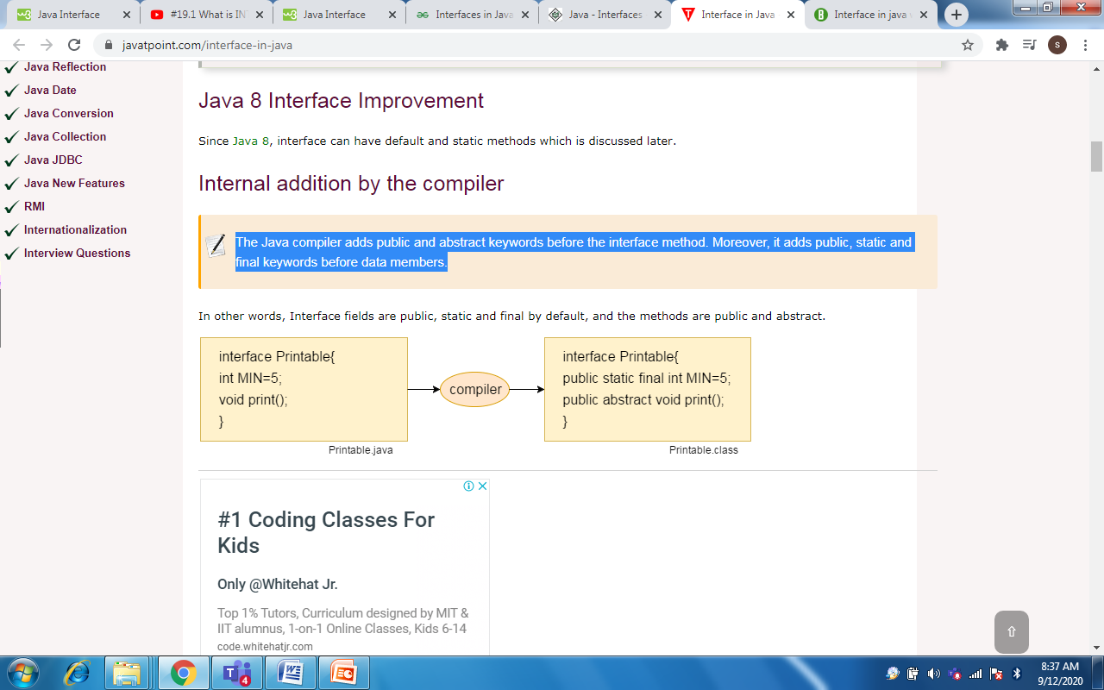
Interfaces
The Java compiler adds public and abstract keywords before the interface method. Moreover, it adds public, static and final keywords before data members. We don’t have to add it explicitly.
The code for the method( void print() in the above example) is not included in the interface since it is abstract in nature.
The class that implements this interface must define the code for the method

Slide 5
Interfaces
Class | Interface
The members of a class can be constant or variables | The members of an interface are always declared as constant. It is declared public static final.
The class definition can contain the code for each of its methods. That is, the methods can be abstract or non-abstract | The methods in an interface are abstract in nature. There is no code associated with them. It is later defined by the class that implements the interface.
It can be instantiated by declaring objects | It cannot be used to declare objects. It can only be inherited by a class
It can use various access specifiers like public, private or protected. | It can only use the public access specifier.

Slide 6
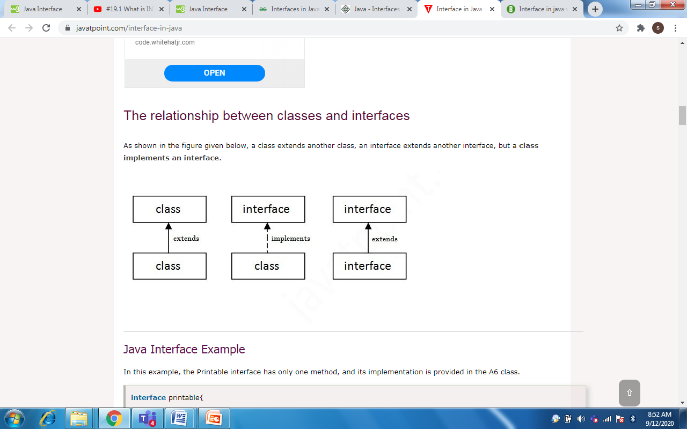

Slide 7
Interfaces
An interface can also be extended. That is an interface can be subinterfaced from other interfaces.
The new subinterface will inherit all the members of the super interface.
General form: interface name2 extends name1
{
Body of name2
}
interface ItemConstants { int code=1001; string name=”Fan”; } interface Item extends ItemConstants { void display(); }

Slide 8
Interfaces
We can combine several interface together into a single interface.
interface ItemConstants { int code=1001; string name=”Fan”; } interface ItemMethods { void display(); } interface Item extends ItemConstants, ItemMethods { ------------------ }

Slide 9
Interfaces
While interfaces are allowed to extend to other interfaces, subinterfaces cannot define the methods declared in superinterfaces.
Subinterfaces are still interfaces, not classes.
It is the responsibility of any class that implements the derived interface to define all the methods.

Slide 10
Interfaces
It is necessary to create a class that inherits the given interface.
General form: Class classname implements interfacename
{
Body of classname
}
More General form:
Class classname extends superclass implements interface1,
interface2, … . . . .
{
Body of classname
}

Slide 11
interface Area { final static float pi=3.14F; float compute(float x, float y); } class Rectangle implements Area { public float compute(float x, float y) { return x*y; } } class Circle implements Area { public float compute(float x, float y) { return pi*x*x; } }
class InterfaceTest { public static void main(String a[]) { Rectangle rect=new Rectangle(); Circle cir=new Circle(); Area area; area = rect; System.out.println("Area of the rectangle : "+area.compute(10,20)); area = cir; System.out.println("Area of the circle : "+area.compute(10,0)); } }
Output: Area of the rectangle : 200 Area of the circle : 314

Slide 12
Example: To show that Interfaces support multiple inheritance
interface AnimalEat
{ void eat(); }
interface AnimalTravel
{ void travel(); }
class Animal implements AnimalEat, AnimalTravel //This is OK
{
public void eat() { System.out.println("Animal is eating");}
public void travel() {System.out.println("Animal is travelling"); } }
public class Demo {
public static void main(String args[]) {
Animal a = new Animal();
a.eat(); o/p Animal is eating
a.travel(); } } Animal is travelling
//Note: This will not be possible if AnimalEat and AnimalTravel are classes

Slide 13
class Test { float part1, part2; void getMarks(float m1, float m2) { part1=m1; part2=m2; } void putMarks() { System.out.println("Part1="+part1); System.out.println("Part2="+part2); } } interface Sports { float sportWt=6.0F; void putWt(); }
class Results extends Test implements Sports { float total; public void putWt() { System.out.println("Sports Wt="+sportWt); } void display() { total=part1+part2+sportWt; putMarks(); putWt(); System.out.println("Total Score="+total); } } class Hybrid { public static void main(String a[]) { Results student1=new Results(); student1.getMarks(27.5F,33.0F); student1.display(); } }
Output: Part1= 27.5 Part2 = 33.0 Sports Wt=6.0 Total Score = 66.5

Slide 14
Nested Interface in Java
We can declare interfaces as member of a class or another interface. Such an interface is called as member interface or nested interface.
Interface in a class
Interfaces (or classes) can have only public and default access specifiers when declared outside any other class . This interface declared in a class can either be default, public, protected not private.

Slide 15
Example 1
class NestedInterface {
interface myInterface {
void demo();
}
class Inner implements myInterface {
public void demo() {
System.out.println("Welcome to Nested Interface"); }
}
public static void main(String args[]) {
Inner obj=new NestedInterface().new Inner();
obj.demo();
} // o/p Welcome to Nested Interface
}

Slide 16
You can also access the nested interface using the class name as −
Example 2
class Test {
interface myInterface { void demo(); }
}
class Sample implements Test.myInterface {
public void demo() {
System.out.println(“Welcome to Nested Interface");
}
public static void main(String args[]) {
Sample obj = new Sample();
obj.demo(); // o/p Welcome to Nested Interface
}
}

Slide 17
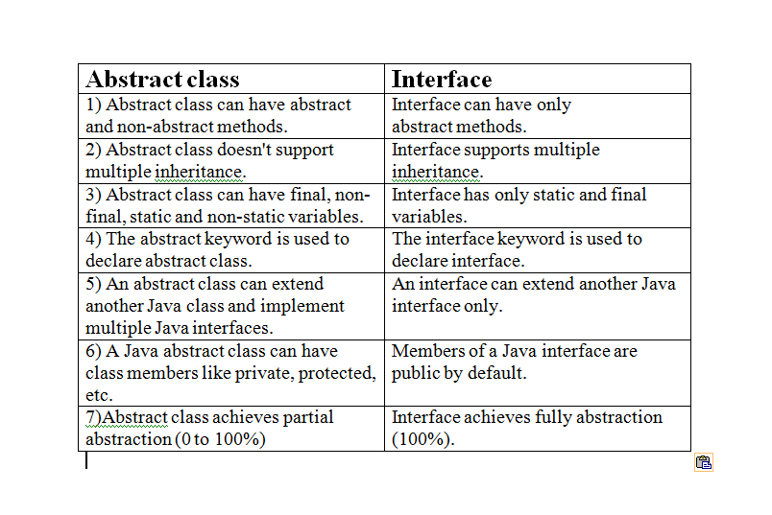
Abstract class vs. Interfaces
Note: Static functions are also allowed in interfaces

Slide 18
Packages
A package is a group of classes that are defined by a name. That is, if you want to declare many classes within one element, then you can declare it within a package.
Packages group variety of classes and/or interfaces together.
Packages allow us to use classes from other programs without physically copying them into the program under development.
Packages act as containers for classes.
Java packages are classified into two types:
  Java API Package
  User defined package

Slide 19
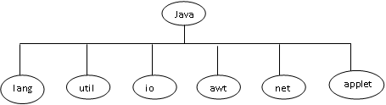
Packages : Java API Packages
Package name | Contents
java.lang | They are automatically imported. They include classes for primitive types, strings, math functions, threads and exceptions
java.util | Language utility classes such as vectors, hash tables, random numbers, date etc.
java.io | They provide facilities for the input and output of data.
java.awt | Set of classes for implementing GUI. They provide classes for windows, button, lists, menus and so on.
java.net | Classes for networking. They include classes for communicating with local computers as well as with internet servers
java.applet | Classes for creating and implementing applets.

Slide 20
Packages : Java API Packages
Two ways of accessing the classes stored in a package.
  Use the fully qualified class name of the class that we want to use
    Example: java.awt.Color
  Import the package
    Syntax 1: import packagename.classname;
    Syntax 2: import packagename.*;
    Import statements must appear at the top of the file, before any class declarations.
    Example : import java.awt.Color;
    Example: import java.awt.*;
    It brings all classes of java.awt package.

Slide 21
Packages : User Defined Packages
Steps to create user defined packeges:
  Declare the package at the beginning of a file using the form :
  package packagename;
  Define the class that is to be put in the package and declare it public
  Create a subdirectory under the directory where the main source files are stored. Subdirectory name must match the package name exactly.
  Store the listing as the classname.java file in the subdirectory created
  Compile the file. This create .class file in the subdirectory

Slide 22
Packages : User Defined Packages
Example: package firstPackage;
public class FirstClass
{
(body of class)
}
This file should be saved as a file called FirstClass.java , and located in a directory named firstPackege under the current working directory.
A Java package file can have more than one class definitions. In such cases, only one of the classes may be declare public and that class name with .java extension is the source file name.
If we omit the package statement, the class names are put into the default package, which has no name.

Slide 23
Packages : User Defined Packages
Java supports the concepts of package hierarchy.
General form : package pkg1[.pkg2[.pkg3]];
Example : package firstPackage.secondPackage;
  Store this package in a subdirctory names firstPackage/secondPackage
Syntax for Accessing a User Defined Package:
import package1[.package2][.package3].classname;
or
import packagename.*;

Slide 24
ClassA.java
PackageTest2.java
package package1; public class ClassA { public void displayA() { System.out.println(“Class A”); } }
import package1.ClassA; import package2.*; class packageTest2 { public static void main(String args[]) { ClassA objectA=new ClassA(); ClassB objectB=new ClassB(); objectA.displayA(); objectB.displayB(); } }
ClassB.java
package package2; public class ClassB { Protected int m=10; public void displayB() { System.out.println(“Class B”); System.out.println(“m=”+m); } }
Output: Class A Class B m=10

Slide 25
Packages : User Defined Packages
When we import multiple packages it is likely that two or more packages contain classes with identical names.
Example:
When we import and use these packages like:
package pack1; public class Student {……………………….}
package pack2; public class Student {……………………….}
import pack1.*; import pack2.*; Student Student1;// error
import pack1.*; import pack2.*; pack1.Student Student1; pack2.Student Student2;
Correct

Slide 26
Packages : User Defined Packages
It is possible to subclass a class that has been imported from another package.
PackageTest3.java
ClassB.java
import package2.ClassB; class ClassC extends ClassB { int n=20; void display() { System.out.println(“Class C”); System.out.println(“m=”+m); System.out.println(“n=”+n); } } class PackageTest3 { public static void main(String args[]) { ClassC objectC=new ClassC(); objectC.displayB(); objectC.displayC(); } }
package package2; public class ClassB { protected int m=10; public void displayB() { System.out.println(“Class B”); System.out.println(“m=”+m); } }
Output: Class B m=10 Class C m=10 n=20

Slide 27
Packages : User Defined Packages
If we want to create a package with multiple public classes in it, follow the steps:
  Decide the name of the package
  Create a subdirectory with this name under the directory where the main source files are stored.
  Create classes that are to be placed in the package in separate source files and declare the package statement
  package packagename;
  at the top of each source file
  Switch to the subdirectory created earlier and compile each source file. When compiled, the package would contain .class files of the all source files.

Slide 28
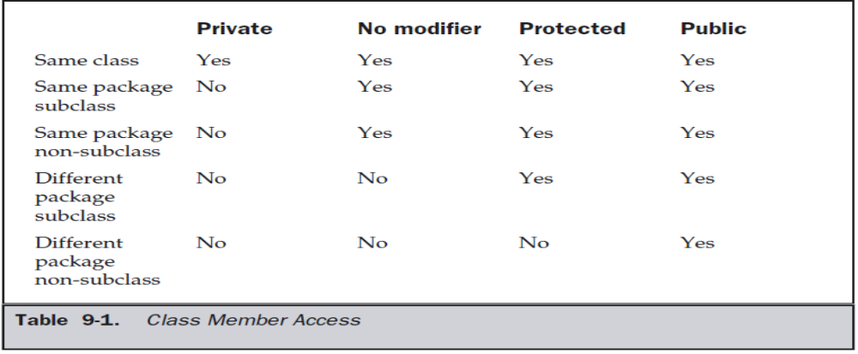
Packages : Access Protection
Private – only within class
Default – it is visible to subclasses as well as to other classes in the same package.
Protected – If you want to allow an element to be seen outside your current package, but only to classes that subclass your class directly, then declare that element protected.
Public – can be accessed from anywhere

Slide 29
package p1; public class Protection { int n = 1; private int n_pri = 2; protected int n_pro = 3; public int n_pub = 4; public Protection() { System.out.println("base constructor"); System.out.println("n = " + n); System.out.println("n_pri = " + n_pri); System.out.println("n_pro = " + n_pro); System.out.println("n_pub = " + n_pub); } }
package p1; class Derived extends Protection { Derived() { System.out.println("derived constructor"); System.out.println("n = " + n); // System.out.println("n_pri = " + n_pri); System.out.println("n_pro = " + n_pro); System.out.println("n_pub = " + n_pub); } }
package p1; class SamePackage { SamePackage() { Protection p = new Protection(); System.out.println("same package constructor"); System.out.println("n = " + p.n); // System.out.println("n_pri = " + p.n_pri); System.out.println("n_pro = " + p.n_pro); System.out.println("n_pub = " + p.n_pub); } }
Protection.java
Derived.java
SamePackage.java

Slide 30
package p2; class Protection2 extends p1.Protection { Protection2() { System.out.println("derived other package constructor"); // System.out.println("n = " + n); // System.out.println("n_pri = " + n_pri); System.out.println("n_pro = " + n_pro); System.out.println("n_pub = " + n_pub); } }
Protection2.java
package p2; class OtherPackage { OtherPackage() { p1.Protection p = new p1.Protection(); System.out.println("other package constructor"); // System.out.println("n = " + p.n); // System.out.println("n_pri = " + p.n_pri); // System.out.println("n_pro = " + p.n_pro); System.out.println("n_pub = " + p.n_pub); } }
OtherPackage.java

Slide 31
Packages : User Defined Packages
When we import a package into a file, all public classes are imported.
To hide few classes from external access, declare those as non public.
Example:
The class Y can be seen and used only by the other classes in the same package.
package p1; public class X { //body of X } class Y { //body of Y }
import p1.*; X objectX; //correct Y objectY; //error. Y is not available

Slide 32
Exception Handling
An exception is an abnormal condition that arises in a code sequence at run time.
Type of Errors :
  Compile time errors
    These errors are detected and displayed by the Java compiler
    Most of the compile time errors are due to typing mismatch
    Ex: Missing ;, Mismatch of brackets, Misspelling of keywords and identifiers, Missing double quotes in string etc.
  Run time errors
    Such programs may produce wrong results due to wrong logic or may terminate due to errors such as stack overflow.
    Ex: dividing an integer by zero, Accessing an element that is out of the bounds of an array, trying to save an element into an array of incompactible type etc.
    When such errors are encountered, Java generates an error message and aborts the program.

Slide 33
Exception Handling : Exception Types
Throwable is at the top of the exception class hierarchy. Immediately below Throwable are two subclasses :
  Exception
    This class is used for exceptional conditions that user programs should catch.
    Used to create our own custom exception types.
    There is an important subclass of Exception, called RuntimeException. Exceptions of this type are automatically defined for the programs that you write and include things such as division by zero and invalid array indexing.
  Error
    These exceptions are not expected to be caught under normal circumstances by our program.
    These are used by the Java run-time system to indicate errors having to do with the run-time environment
    Ex: Stack overflow

Slide 34
Exception Handling
When an exceptional condition arises, an object representing that exception is created and thrown in the method that caused the error
Exceptions can be generated by
  The Java run-time system : due to the violation of the rules of Java language or constraints of the Java execution environment
  Manually generated by our code

Slide 35
Exception Handling
Uncaught Exceptions are handled by Java runtime system.
class Exc0 { public static void main(String args[]) { int d = 0; int a = 42 / d; } }
Output: java.lang.ArithmeticException: / by zero at Exc0.main(Exc0.java:6)

Slide 36
class Exc1 { static void subroutine() { int d = 0; int a = 10 / d; } public static void main(String args[]) { Exc1.subroutine(); } }
Output: java.lang.ArithmeticException: / by zero at Exc1.subroutine(Exc1.java:6) at Exc1.main(Exc1.java:10)

Slide 37
Exception Handling
Java exception handling is managed via five keywords:
  try : Program statements that we want to monitor for exceptions are contained within a try block.
  throw : To manually throw an exception.
  throws : Any exception that is thrown out of a method must be specified by a throws clause.
  catch : to catch exceptions and handle it in some rational manner.
  finally : Any code that absolutely must be executed before a method returns is put in a finally block.

Slide 38
Exception Handling
General Form :
try { // block of code to monitor for errors } catch (ExceptionType1 exOb) { // exception handler for ExceptionType1 } catch (ExceptionType2 exOb) { // exception handler for ExceptionType2 } // ... finally { // block of code to be executed before try block ends }
ExceptionType is the type of exception that has occurred.

Slide 39
Exception Handling : try and catch
class Exc2 { public static void main(String args[]) { int d, a; try // monitor a block of code. { d = 0; a = 42 / d; System.out.println("This will not be printed."); } catch (ArithmeticException e) { System.out.println("Division by zero."); } System.out.println("After catch statement."); } }
Output: Division by zero. After catch statement.

Slide 40
Exception Handling : try and catch
Enclose the code that we want to monitor inside a try block.
Immediately following the try block, include a catch clause that specifies the exception type that we wish to catch.
Once an exception is thrown, program control transfers out of the try block into the catch block. Execution never returns to the try block from a catch.
Once the catch statement has executed, program control continues with the next line in the program following the entire try/catch mechanism

Slide 41
Exception Handling : Multiple catch clauses
class MultiCatch { public static void main(String args[]) { try { int a = args.length; System.out.println("a = " + a); int b = 42 / a; int c[] = { 1 }; c[42] = 99; } catch(ArithmeticException e) { System.out.println("Divide by 0: " + e); } catch(ArrayIndexOutOfBoundsException e) { System.out.println("Array index oob: " + e); } System.out.println("After try/catch blocks."); } }
More than one exception could be raised by a single piece of code.
To handle this type of situation, we can specify two or more catch clauses, each catching a different type of exception.
When an exception is thrown, each catch statement is inspected in order, and the first one whose type matches that of the exception is executed.
After one catch statement executes, the others are bypassed, and execution continues after the try/catch block.

Slide 42
Exception Handling : Multiple catch clauses
class SuperSubCatch { public static void main(String args[]) { try { int a = 0; int b = 42 / a; } catch(Exception e) { System.out.println("Generic Exception “); } /*/This catch is never reached catch(ArithmeticException e) { // ERROR – unreachable System.out.println(“Never reached."); } } }
The exception subclasses must come before any of their superclasses.

Slide 43
Exception Handling : nested try
A try statement can be inside the block of another try.
Each time a try statement is entered, the context of that exception is pushed on the stack.
If an inner try statement does not have a catch handler for a particular exception, the stack is unwound and the next try statement’s catch handlers are inspected for a match.
This continues until one of the catch statements succeeds, or until all of the nested try statements are exhausted.
If no catch statement matches, then the Java run-time system will handle the exception.

Slide 44
class NestTry { public static void main(String args[]) { try { int a = args.length; int b = 42 / a; // no command-line args, generate a divide-by-zero exception. System.out.println("a = " + a); try // nested try block { if(a==1) a = a/(a-a); // 1 cmd-line arg, generate a divide-by-zero exception if(a==2) { int c[] = { 1 }; c [42] = 99; // generate an out-of-bounds exception } } catch(ArrayIndexOutOfBoundsException e) { System.out.println("Array index out-of-bounds: " + e); } } catch(ArithmeticException e) { System.out.println("Divide by 0: " + e); } } }

Slide 45
Exception Handling : Implicitly nested try
class MethNestTry { static void nesttry(int a) { try // implicitly nested try block { if(a==1) a = a/(a-a); // division by zero if(a==2) { int c[] = { 1 }; c[42] = 99; // generate an out-of-bounds exception } } catch(ArrayIndexOutOfBoundsException e) { System.out.println("Array index out-of-bounds: " + e); } } public static void main(String args[]) { try { int a = args.length; int b = 42 / a; System.out.println("a = " + a); nesttry(a); } catch(ArithmeticException e) { System.out.println("Divide by 0: " + e); } } }

Slide 46
Exception Handling : throw
To throw an exception explicitly
Syntax : throw ThrowableInstance;
  ThrowableInstance is an object of type Throwable or a subclass of Throwable.
The flow of execution stops immediately after the throw statement.
The nearest enclosing try block is inspected to see if it has a catch statement that matches the type of the exception.
  If it does find a match, control is transferred to that statement.
  If not, then the next enclosing try statement is inspected, and so on.
  If no matching catch is found, then the default exception handler halts the program and prints the stack trace.

Slide 47
class ThrowDemo { static void demoproc() { try { throw new NullPointerException("demo"); } catch(NullPointerException e) { System.out.println("Caught inside demoproc."); throw e; // rethrow the exception } } public static void main(String args[]) { try { demoproc(); } catch(NullPointerException e) { System.out.println("Recaught: " + e); } } }
Unchecked Exception
Output: Caught inside demoproc. Recaught:java.lang.NullPointerException: demo

Slide 48
Exception Handling : throws
A throws clause lists the types of exceptions that a method might throw.
All exceptions (except those of type Error or RuntimeException, or any of their subclasses) that a method can throw must be declared in the throws clause.
Syntax :
  type method-name(parameter-list) throws exception-list
  {
  // body of method
  }

Slide 49
Exception Handling : throws
This program contains an error and will not compile.
class ThrowsDemo { static void throwOne() { System.out.println("Inside throwOne."); throw new IllegalAccessException("demo"); } public static void main(String args[]) { throwOne(); } }
Checked Exception

Slide 50
class ThrowsDemo { static void throwOne() throws IllegalAccessException { System.out.println("Inside throwOne."); throw new IllegalAccessException("demo"); } public static void main(String args[]) { try { throwOne(); } catch (IllegalAccessException e) { System.out.println("Caught " + e); } } }
Output: inside throwOne caught java.lang.IllegalAccessException: demo

Slide 51
Exception Handling : finally
finally creates a block of code that will be executed after a try/catch block has completed.
finally block is used to handle any exception generated within a try block which is not caught by any of the previous catch statements.
The finally block will execute whether or not an exception is thrown.
If an exception is thrown, the finally block will execute even if no catch statement matches the exception.
Any time a method is about to return to the caller from inside a try/catch block, the finally clause is also executed just before the method returns.
The finally clause is optional. However, each try statement requires at least one catch or a finally clause.

Slide 52
Exception Handling : finally
Syntax :
try { ……………… } finally { …………….. }
try { ……………… } catch(){……………} catch(){……………} catch(){……………} . . finally { …………….. }

Slide 53
class FinallyDemo { // Through an exception out of the method. static void procA() { try { System.out.println("inside procA"); throw new RuntimeException("demo"); } finally { System.out.println("procA's finally"); } } // Return from within a try block. static void procB() { try { System.out.println("inside procB"); return; } finally {System.out.println("procB's finally"); } }
// Execute a try block normally. static void procC() { try { System.out.println("inside procC"); } finally { System.out.println("procC's finally"); } } public static void main(String args[]) { try { procA(); } catch (Exception e) { System.out.println("Exception caught"); } procB(); procC(); } }
Output : inside procA procA’s finally Exception caught inside procB procB’s finally inside procC procC’s finally

Slide 54
Exception Handling : Built in Exceptions
java.lang, package contains several exception classes.
Two types of exceptions:
  Unchecked exceptions
    Since java.lang is implicitly imported into all Java programs, most exceptions derived from RuntimeException are automatically available.
    They need not be included in any method’s throws list.
    The compiler does not check to see if a method handles or throws these exceptions.
  Checked exceptions :
    Some exceptions are defined by java.lang that must be included in a method’s throws list if that method can generate one of these exceptions and does not handle it itself.

Slide 55
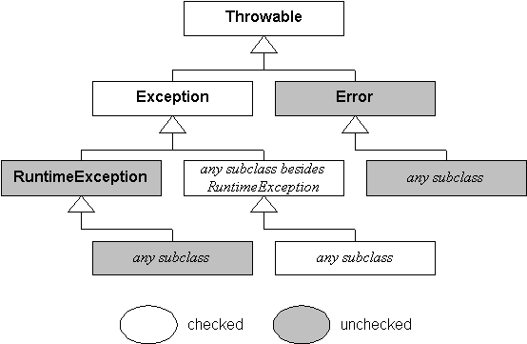

Slide 56
Java’s Unchecked RuntimeException Subclasses
Exception | Meaning
ArithmeticException | Arithmetic error, such as divide-by-zero.
ArrayIndexOutOfBoundsException | Array index is out-of-bounds.
ArrayStoreException | Assignment to an array element of an incompatible type.
ClassCastException | Invalid cast.
IllegalArgumentException | Illegal argument used to invoke a method.
IllegalMonitorStateException | Illegal monitor operation, such as waiting on an unlocked thread.
IllegalStateException | Environment or application is in incorrect state.
IllegalThreadStateException | Requested operation not compatible with current thread state.
IndexOutOfBoundsException | Some type of index is out-of-bounds.
NegativeArraySizeException | Array created with a negative size.
NullPointerException | Invalid use of a null reference.
NumberFormatException | Invalid conversion of a string to a numeric format.
SecurityException | Attempt to violate security.
StringIndexOutOfBounds | Attempt to index outside the bounds of a string.
UnsupportedOperationException | An unsupported operation was encountered.

Slide 57
Java’s Checked Exception Subclasses
Exception | Meaning
ClassNotFoundException | Class not found.
CloneNotSupportedException | Attempt to clone an object that does not implement the Cloneable interface.
IllegalAccessException | Access to a class is denied.
InstantiationException | Attempt to create an object of an abstract class or interface.
InterruptedException | One thread has been interrupted by another thread.
NoSuchFieldException | A requested field does not exist.
NoSuchMethodException | A requested method does not exist.

Slide 58
Exception Handling : User Defined Exceptions
class MyException extends Exception { private int detail; MyException(int a) { detail = a; } public String toString() { return "MyException[" + detail + "]"; } }
class ExceptionDemo { static void compute(int a) throws MyException { System.out.println("Called compute(" + a + ")"); if(a > 10) throw new MyException(a); System.out.println("Normal exit"); } public static void main(String args[]) { try { compute(1); compute(20); } catch (MyException e) {System.out.println("Caught " + e); } } }
Output : Called compute(1) Normal exit Called compute(20) Caught MyException[20]

